Slide 1
ANGULAR 2 - SERVICE

Slide 2
Session Objective
To understand the following features of service with hands-on experience in Angular 2.
Service
Dependency Injection
Lifecycle Hooks
HTTP Service
RXJS - Observables
Http Error Handling

Slide 3
SERVICE

Slide 4
Service
A service is a class with a narrow set of operations proffered to other components
A service is used when a common functionality needs to be provided to various modules
Angular comes with its own dependency injection framework for resolving dependencies
Example:
Database functionality that could be reused among various modules.

Slide 5
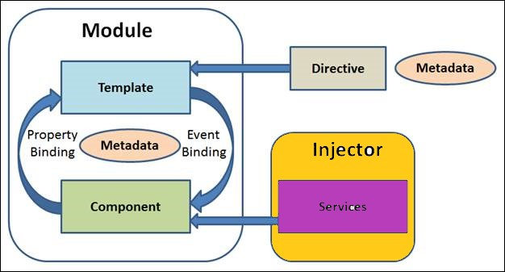
Service cont…
SERVICE

Slide 6


Slide 7
Dependency Injection
“Dependency Injection“ is a way to supply a new instance of a class with the fully formed dependencies it requires
Most dependencies are services
Angular uses dependency injection to provide new components with the services
Service
Component
{constructor(service)}

Slide 8
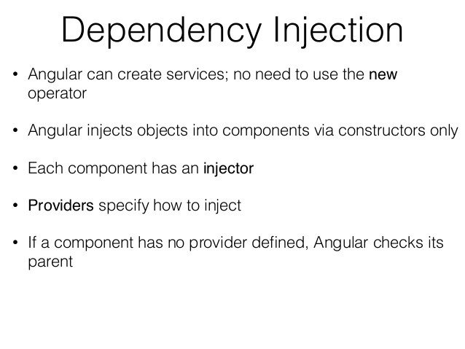
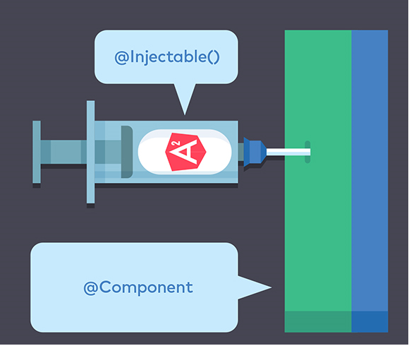
Dependency Injection cont…

Slide 9
Dependency Injection cont…
@Injectable
The service class is decorated with @Injectable to make it available to the Injector for creation
Injector will throw NoAnnotationError when trying to instantiate a class that does not have @Injectable marker

Slide 10
Dependency Injection cont…
Injecting a Service
• Injecting a service is as simple as importing the service class and then defining it within the consumer’s constructor parameters
• Like components, dependencies can also be injected into the constructor of a service
• There can be only one instance of a service type in a particular injector but there can be multiple injectors operating at different levels of the application's component tree. Any of those injectors could have its own instance of the service.
Service

Slide 11
LIFECYCLE HOOKS

Slide 12
Lifecycle Hooks
Directive and component instances have a lifecycle as Angular creates, updates, and destroys them.
Each interface has a single hook method which is prefixed with “ng”
Example:
The OnInit interface has a hook method named ngOnInit()

Slide 13
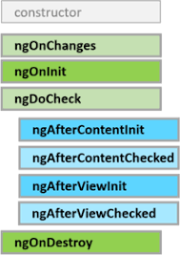
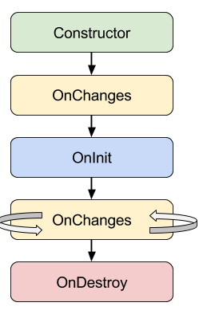
Lifecycle Hooks cont…

Slide 14
Lifecycle Hooks cont…
ngOnChanges()
Respond when Angular (re)sets data-bound input properties. The method receives a SimpleChanges object of current and previous property values.
ngOnInit()
Initialize the directive/component after Angular first displays the data-bound properties and sets the directive/component's input properties.
Called once, after the first ngOnChanges()
ngOnDestroy()
This is the cleanup phase just before Angular destroys the directive/component.

Slide 15
Lifecycle Hooks cont…
Use of ngOnInit() for two main reasons:
To perform complex initializations shortly after construction.
To set up the component after Angular sets the input properties

Slide 16

CREATING SERVICE

Slide 17
Creating Service
Steps to create Service
Create an Interface Iemployee.ts
Create a Service class Employee.service.ts
Create a Component class Employee.component.ts
Create a module app.module.ts

Slide 18
Creating Service cont…
Step 1:
Create an interface IEmployee.ts
Interface:
TypeScript allows to define complex type definitions in the form of interfaces.
This complex type such as an object contains other properties.

Slide 19
Creating Service
Step 2.A:
Create a separate class which has the injectable decorator. The injectable decorator allows the functionality of this class to be injected and used in any Angular JS module.

Slide 20
Creating Service cont…
Step 2.B:
Create a service file named Employee.service.ts
The Injectable decorator is imported from the angular/core module.
A class called EmployeeService is created and decorated with the Injectable decorator.
create a simple function called getEmp(), which returns a array of employee details.

Slide 21
Creating Service cont…
Step 3.A:
Create a file Employee.component.ts
Import Employee.service Service module in the Employee.Component module
Register the Employee.Component.html in the @Component decorator

Slide 22

Creating Service cont…
Step 3.B:
Include it through dependency injection
In the constructor arguments of the component class, we include it through dependency injection:

Slide 23
Creating Service cont…
Step 3.C:
Using Service
The service's methods and properties can be referenced using the private _employeeService

Slide 24
Creating Service cont…
Step 3.D:
In the constructor, define a variable called _employeeService of the type EmployeeService so that it can be called anywhere in the Employee.Component module.
In the ngOnInit lifecyclehook, we called the getEmp() function of the service and assign the output to the value property of the Employee.Component class.

Slide 25
Creating Service cont…
Step 4:
Including the Service in app.module.ts
The difference when including a service in the app.module.ts from including it in a specific component is that, declaring the service in the providers property of the app.module.ts @NgModule metadata, as opposed to the @Component's meta data

Slide 26
HTTP With RxJS OBSERVABLE

Slide 27

HTTP
HTTP is available under the ‘@angular/http’ package.
Import the package and inject it into the component/service.
Get method is used to send an HTTP Request and subscribe to the response Asynchronously.
The response is mapped to the desired object and result is displayed.

Slide 28

Observables
Observables handles multiple values over time makes them a good candidate for working with real-time data
RxJS also provides Observable operators which can used to manipulate the data being emitted. Some of these operators are:
Map
Filter
Take
Skip
Debounce

Slide 29
Observables cont…
Filter will create a new array with all elements that pass the test implemented by a provided function.
Map will create a new array with the results of calling a provided function on every element in this array.

Slide 30
Observables cont…

Slide 31
Observable - HTTP
Angular HTTP library provides Http client for server communication.
get() is the Http client method that uses HTTP GET method to communicate server using HTTP URL.
Pass HTTP URL to Http.get() and it will return the instance of RxJS Observable. To listen values of Observable we need to subscribe it.

Slide 32
Service Using HTTP and Observable
Import HTTP Module in Root Module
Import it in the root module app.module
Add it to the imports metadata array

Slide 33
Service Using HTTP and Observable cont…
Import the Required module in Component/Service

Slide 34
Service Using HTTP and Observable cont…
Inject HTTP service into the component/service

Slide 35
Service Using HTTP and Observable cont…
Call the service method

Slide 36
Service Using HTTP and Observable cont…
The method getEmp () return Observable
Subscribe is defined to retrieve the Observable, it also uses the callback function as argument to access the data
The callback function is notified when Observable emits the array of IEmployee

Slide 37
Service Using HTTP and Observable cont…
Subscribe Callback function
Callback Method | Purpose
onNext | The Observable calls this method whenever the Observable emits an item. The emitted item is passed as a parameter to this method
onError | The Observable calls this method if there is an error
onCompleted | The Observable calls this method after it has emitted all item. If it is calling onNext for the final time

Slide 38
Service Using HTTP and Observable cont…
Call the HTTP Service

Slide 39
Service Using HTTP and Observable cont…
Get() method returns Observable of Response
Transform the response to an array of IEmployee using map operator
The map operator of observables is to extract the data of the response as JSON content.

Slide 40
HTTP Error Handling
Error handling in HTTP is done using catch operator
Import the required
Import ‘rxjs/add/operator/catch’

Slide 41
HTTP Error Handling cont…
Mark the exception in the Service class

Slide 42
HTTP Error Handling cont…
Handle the exception in Component class

Slide 43
HTTP Error Handling cont…
Display the message using HTML

Slide 44

Let Me
recollect

Slide 45
Recollect
A service is used when a common functionality needs to be provided to various modules
Directive and component instances have a lifecycle in Angular that creates, updates and destroys
Observables handles multiple values over time makes them a good candidate for working with real-time data
Dependency Injection is a way to supply a new instance of a class with the fully formed dependencies it requires

